Slide 1

Bootleg Macro Pleb

Slide 2
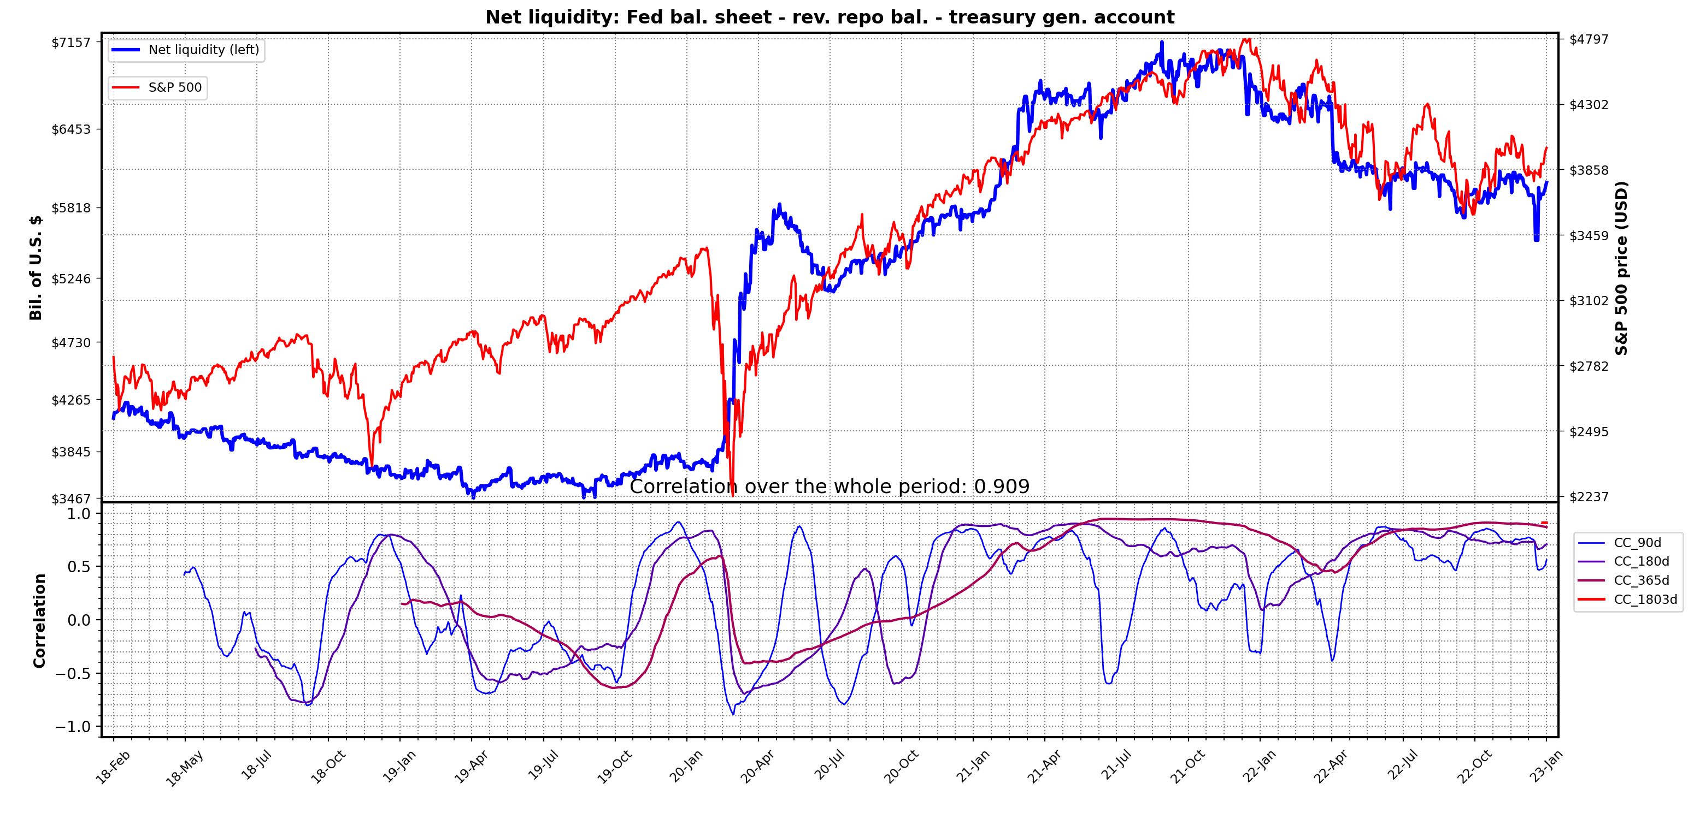
NET LIQUIDITY
1/ FEDERAL RESERVE NET LIQUIDITY (NLQ): this is one of the most important macro metrics to watch. Originally formulated by @DariusDale and 42 Macro. This provides a daily estimate of the total liquidity being provided to markets by the Fed, treasury and big money funds.
2/ Following March 2020, the huge surge in net liquidity that followed as a result of QE made it one of the dominant driving forces behind equity markets & bitcoin. High correlation is now seen between SPX,NDQ,DJI,BTC etc & NLQ. Great intro here by @MaxAnderson:
3/ You’ve probably heard of this metric by now & would like to know how to track this for yourself. Max’s thread provides a great explanation of why NLQ is important & where you can get the data from. You can see NLQ on tradingview using WALCL-RRPONTSYD-WTREGEN in search bar.
4/ TV can only get you NLQ weekly series. The treasury general account (TGA) & RevRepo balances are updated daily though and there may be some advantage to viewing daily updated NLQ. I’ve written a python script to pull and display the daily NLQ series so you don’t have to.
5/ The script pulls the Fed bal. sheet (weekly) & RevRepo bal (daily) data from FRED. It gets the TGA bal. direct from treasury site (daily data). You can choose up to 5 assets to also plot for comparison. Correlation (CC) is calculated for the first asset (BTC here below).

Slide 3
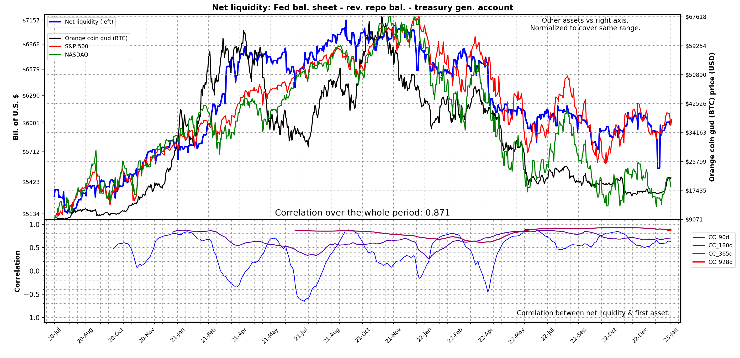
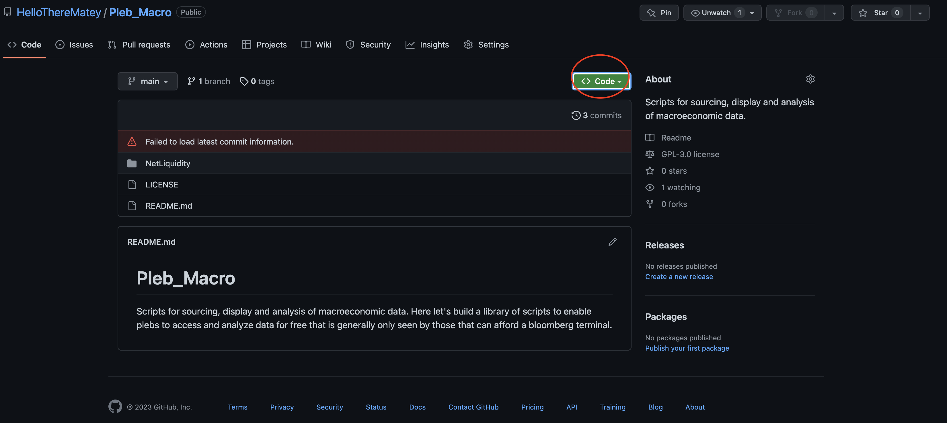
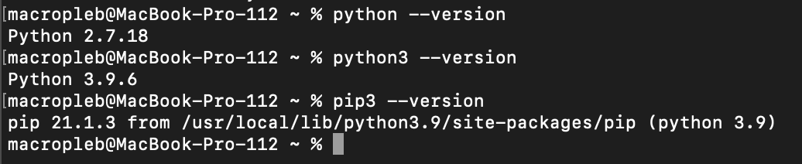
6/ The script is easy to use even if you have never coded. Here, I’ll show how it can be done using the terminal & excel on windows,mac or linux. Go to the github repo and download the repo as zip.
7/ Unzip & place NetLiquidity project folder where you wish. Open terminal, Enter: python –vsersion to check if python installed. Also check for pip. On mac use add 3 to python and pip cmd as old version also installed by default.

Slide 4
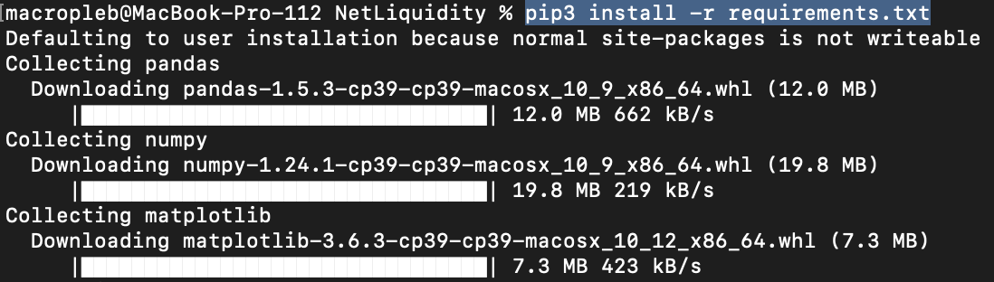
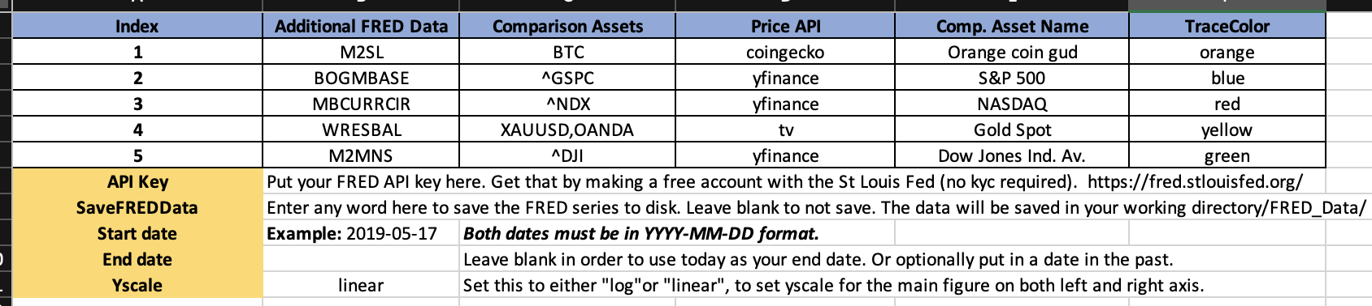
8/ If you have no python/pip installed you’ll see ‘command not found’. On windows, search ‘python’ on the windows app store to download latest version free. Mac/linux see: docs.python-guide.org/starting/installation/
9/ Now you have python and pip, you’ll need the required modules that the script uses. Type ‘cd’ and drag & drop the ‘NetLiquidity’ folder onto the terminal + hit enter. That will set it as the working directory.
10/ Use pip to install the required python modules: pip install –r requirements.txt (pip3 on mac). These are collections of python scripts like mine yet are far better written.
10/ Once that is done you are ready to use the script. Open NetLiquidity_InputParams.xlsx. All parameters are set using this excel file. Simply enter ticker names, start date etc in the cells indicated in “Parameters’ sheet, save file. Helpful info found in other sheet.
11/ .csv or .ods etc. could be used as free alternatives to excel, let me know if you want me to add support for that. You can choose up to 5 assets to plot atop NLQ & 5 extra series to pull from FRED.

Slide 5
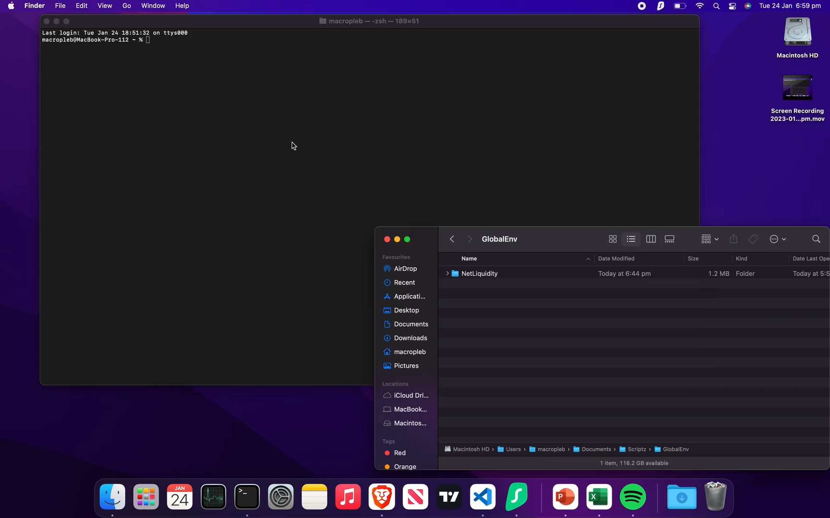
12/ Now run the script. Enter python ShowNetLiq.py, to run the script (python3-mac). Here’s a video of the process below.

